Slide 1






AI & AUTOMATION
IN HOME CARE
Streamlining Ops with AI & Automation
David
Adress

Slide 2


AI & AUTOMATION
IN HOME CARE
Streamlining Ops with AI & Automation
David
Adress

Slide 3
We’re not your average IT company.
We’ve been automating, integrating, and enhancing operations for home care agencies for years.
Our team of developers spends their days improving the systems that power your agency — from AI-driven automation and business intelligence dashboards to custom integrations that connect every part of your workflow.
We’ve even helped popular industry vendors build their own tools — so chances are, we’ve already touched a part of your ecosystem.
Imperial
Technology
Partners
AI & AUTOMATION
IN HOME CARE
Technology is in our DNA
Streamlining Ops with AI & Automation
David
Adress

Slide 4

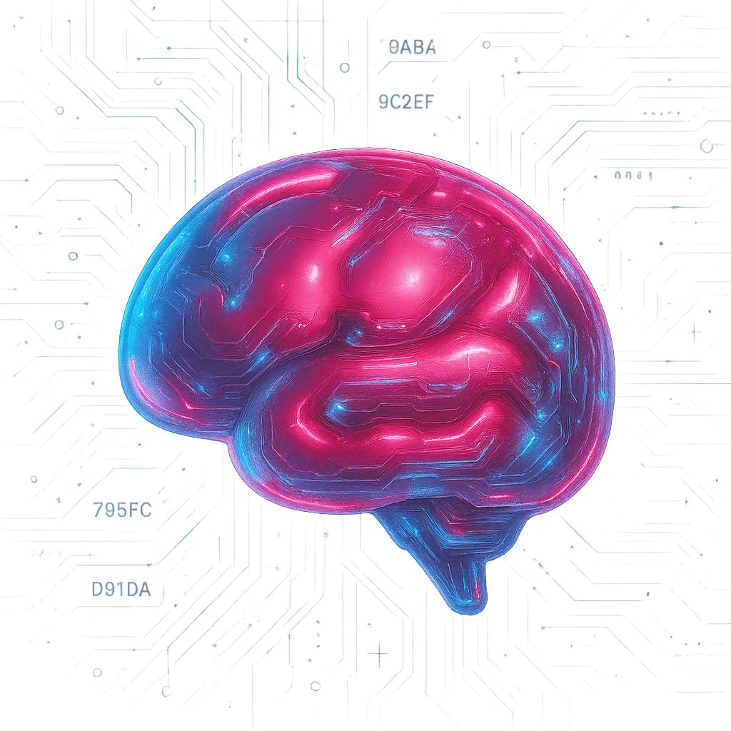



AI vs. Automation
Where They Meet
AI & AUTOMATION
IN HOME CARE
AI
Learns from data to make decisions and adapt.
Automation
Follows rules to handle repetitive tasks.
Streamlining Ops with AI & Automation
Smart Automation
AI thinks, automation acts — creating systems that learn, decide, and act automatically.
Example:
Predicts no-shows, finds errors, chats with users.
Come Stop
Example:
Send invoices, sync data, trigger alerts.
by our Booth!
Goal:
Efficiency.
Goal:
Intelligence.
David
Adress

Slide 5
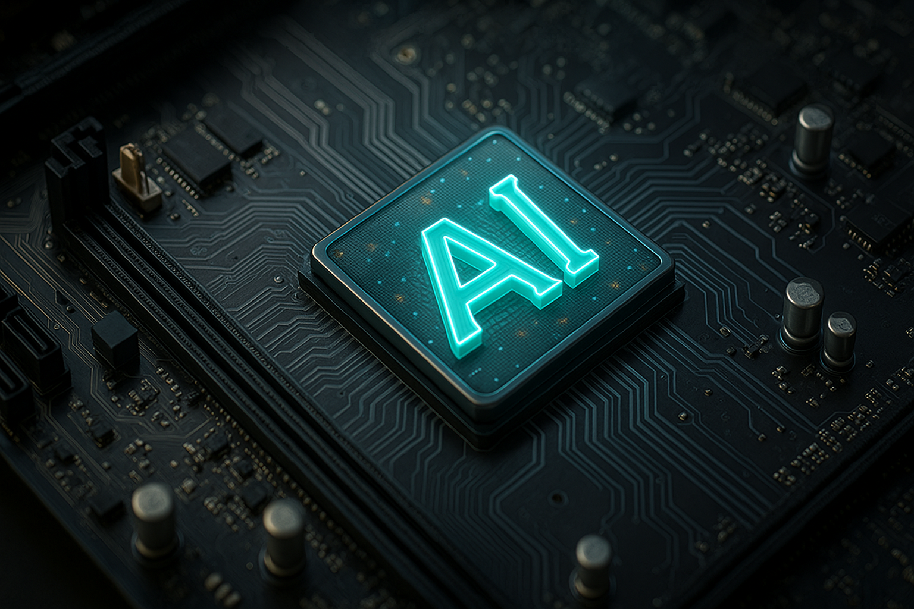


REACTS
PREDICTS
We’re not your average IT company.
We’ve been automating, integrating, and enhancing operations for home care agencies for years.
Our team of developers spends their days improving the systems that power your agency — from AI-driven automation and business intelligence dashboards to custom integrations that connect every part of your workflow.
We’ve even helped popular industry vendors build their own tools — so chances are, we’ve already touched a part of your ecosystem.
AI or Not AI
AI & AUTOMATION
Not even a question
IN HOME CARE
Streamlining Ops with AI & Automation
Come Stop
by our Booth!
Agency A
Scrambles — phones ringing, visits missed.
Agency B
Already knew — their system warned them Sunday night.

Slide 6
?
What AI Can Do
Analyze data from multiple systems and documents instantly
Predict trends, risks, or upcoming issues
Call & Converse naturally with patients or staff
Summarize documents, forms, or notes
Automate Actions based on insight (reschedule, alert, assign)
Generate Reports and visual dashboards in seconds
Learn & Adapt from feedback and outcomes
Assist Staff with decisions, reminders, and communication
AI & AUTOMATION
IN HOME CARE
Streamlining Ops with AI & Automation
David
Adress

Slide 7
The Cost of Standing Still
Tighter Margins: Costs rise, reimbursements don’t — squeezing every dollar.
Do More with Less: Fewer staff, higher demand, and endless paperwork.
Burnout Builds: Manual work drains time, morale, and talent retention.
Missed Insights: Data sits idle — decisions are reactive, not predictive.
Lost Efficiency: Repeated tasks, duplicate entry, no automation.
Compliance Risks: The slower you adapt, the faster regulations catch up.
Falling Behind Competitors: Others leverage AI — you’re still chasing spreadsheets.
Opportunity Cost: Every hour spent fixing today’s problems delays tomorrow’s growth.
AI & AUTOMATION
IN HOME CARE
Streamlining Ops with AI & Automation
David
Adress

Slide 8


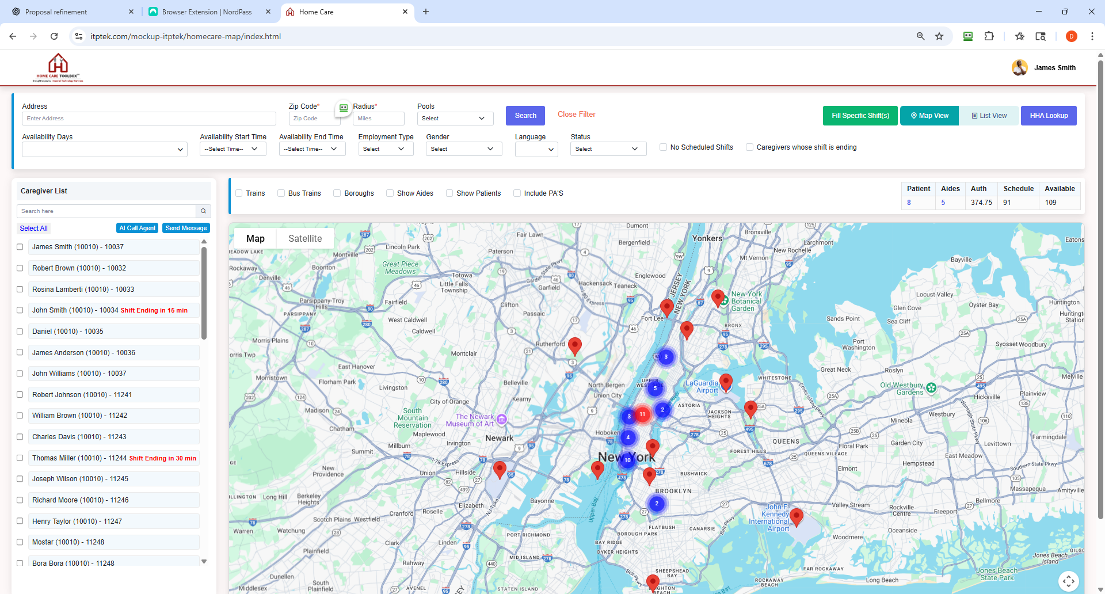
Compliance Follow-up​
Calling Agents
How many hours is staff on the phone?
Staffing Agents
Compliance Follow-up
Document Follow-up
Timesheet Follow up
Check Ins
Recruiting Outreach
Visit Confirmations
Surveys/Feedback
Training Reminders
Scheduling Inservice
IN HOME CARE
Streamlining Ops with AI & Automation
David
Adress
AI Staffing Agent – Automatically calls caregivers to staff cases in their preferred language.

Slide 9
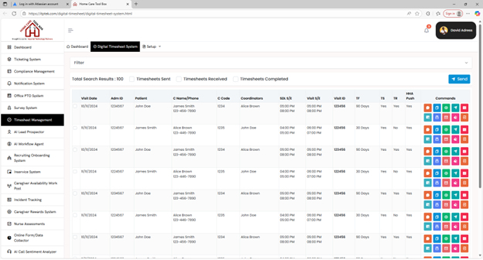
Calling Agents
How many hours is staff on the phone?
IN HOME CARE
Streamlining Ops with AI & Automation
Follow up on missing timesheets, did an aide make it to the visit, visit verification and more.

Slide 10
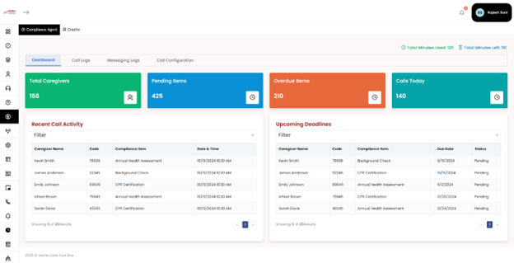
Calling Agents
How many hours is staff on the phone?
IN HOME CARE
Streamlining Ops with AI & Automation
Have an AI Calling Agent follow up on all your compliance items – Update your EMR

Slide 11

Data & Analysis
Analyzing Data Sets
Reviewing & Identifying Documents
Verify Signatures
ChatGPT Reporting Interface – PCC, HHA Exchange, GP, Intacct, etc.
Spot Trends
AI Insights and Command Center – All Levels
Sentiment Analysis – Calls / Notes
Predictive Alerts – Ex: Identify call-outs, Patient risks
Exception Detection/Fraud
Smart Summaries – Auto-generate reports, meeting recaps, and insights
Streamlining Ops with AI & Automation
David
Adress

Slide 12

Marketing & Outreach
Lead Harvester
Videos / Marketing Content – Auto Posts
Surveys/Collect Feedback
Make sure campaigns multiligual
Personalized Outreach Videos
AI Intake – Capture the whole intake process
AI Chat Outreach – Engage website visitors or applicants instantly
Reputation Monitoring – Flag negative reviews or feedback early
Campaign Analytics – Measure what content converts and adjust automatically
Streamlining Ops with AI & Automation

Slide 13
Training &
Communication
Produce Inservice Videos
Personalized Onboarding Videos
Smart Texting / Language Tools
Chat Bots / Knowledgebases
Answering Calls – Assisting Based on Rules Engine
Live Translation – Calls and Live Meetings (e.g., Offboarding, Discharge Interviews)
Streamlining Ops with AI & Automation

Slide 14
Automations and Everything Else – It adds up fast!
Auto terminations/Auto discharging if certain rules are hit
Trigger Alerts for missing data
More Frequent Eligibility updates (epace)
Compliance Reference Checks
Cleanup visits that should have been deleted or missed
Update visits with wrong billing codes, missing POC's
Auto Create and Modify visits/shifts
Authorization/Contract Follow-up/Process Emails
Create tickets based on various rules
EVV & POC reminder, PTO Management
Inservice Scheduling
Streamlining Ops with AI & Automation

Slide 15
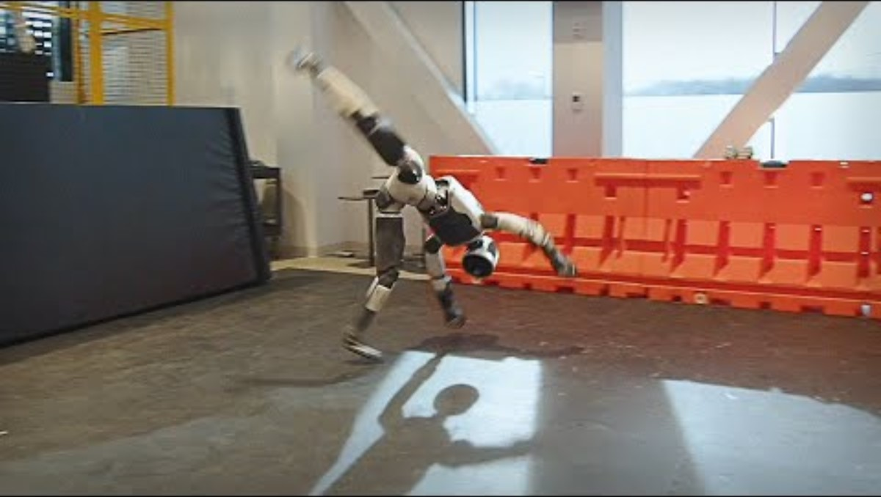
Robotic Caregivers Next? – Maybe at the Home Care Show 2030
AI & AUTOMATION
IN HOME CARE
Streamlining Ops with AI & Automation
David
Adress

Slide 16
Some Demos
AI & AUTOMATION
IN HOME CARE
Streamlining Ops with AI & Automation
David
Adress

Slide 17
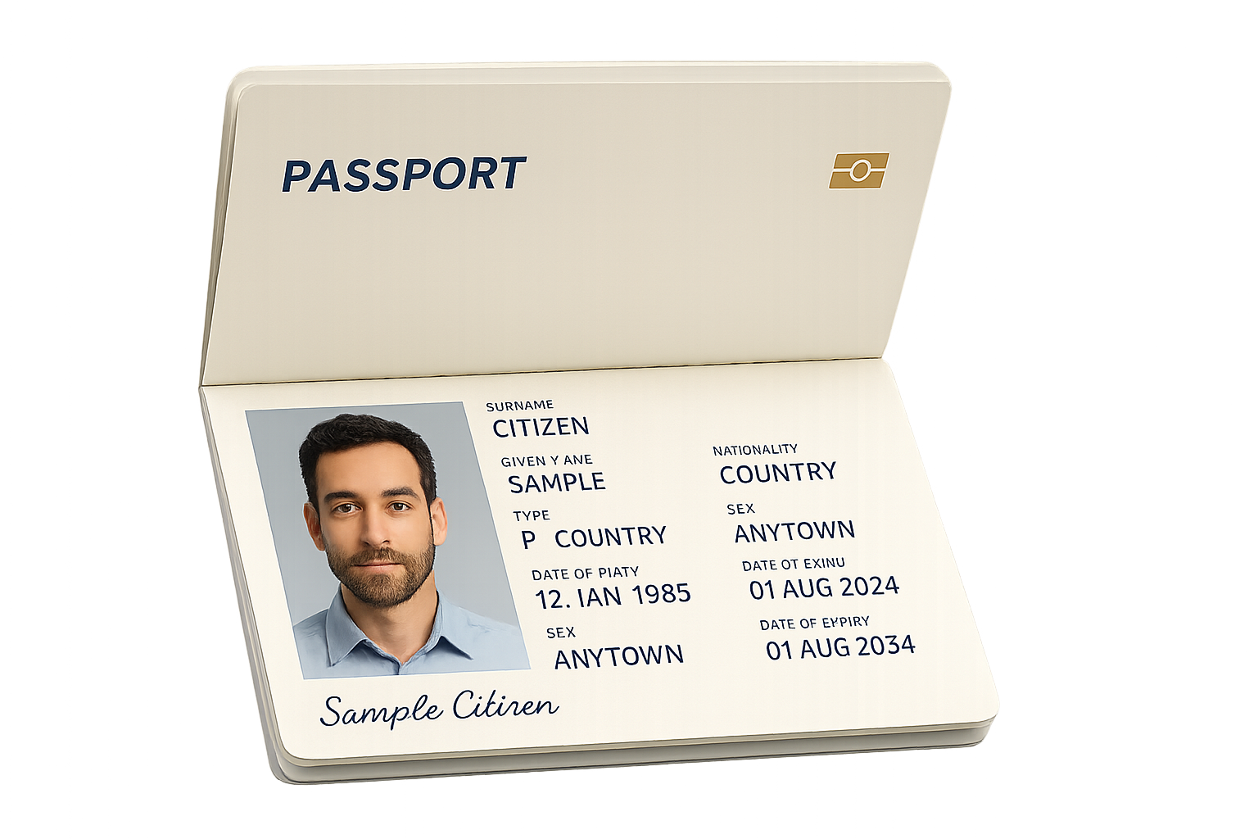
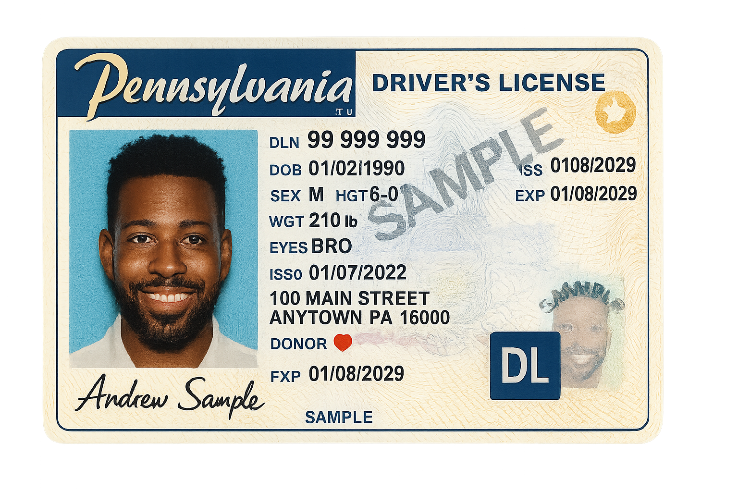
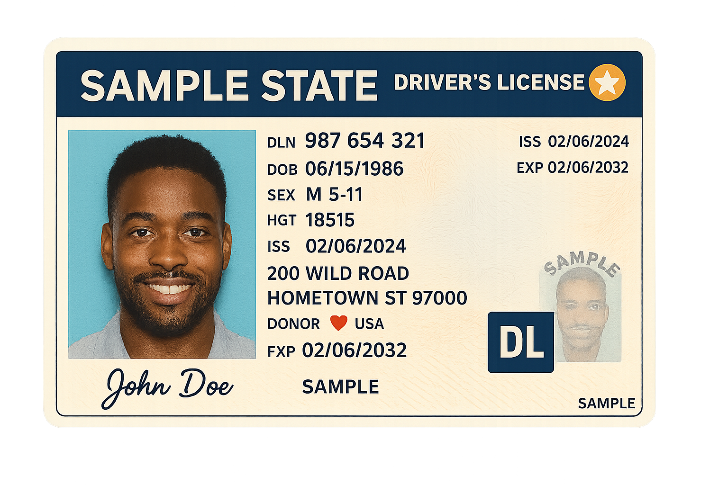
Analyze
Documents
Type of Document: This document is a sample Pennsylvania Driver’s License.
Intended Recipient or Audience: The intended recipient or audience appears to be a government agency, law enforcement, or an entity that requires verification of identification.
Legitimacy: The document appears to be a legitimate sample of a Pennsylvania Driver’s License. The formatting, content, and language are consistent with official driver’s licenses. The presence of a sample watermark and the word “SAMPLE” on the photo and in the signature suggest that this is indeed a sample rather than a fraudulent document. There are no visible signs of tampering or obvious discrepancies in the information provided.
Expired or Outdated Information: The expiration date listed is 01/08/2029, and the issue date is 01/07/2022, which suggests that the license is currently valid. There is no information that appears to be expired or outdated.
Likelihood of Legitimacy: On a scale from 0 to 100, I would rate the likelihood that this is a legitimate and official document as a sample at 95. The document closely resembles official Pennsylvania Driver’s Licenses, with correct formatting, appropriate security features (such as the watermark and the gold star), and realistic content. The clear indication that it is a “SAMPLE” suggests it is an authentic sample provided for reference or testing purposes rather than a counterfeit document.
Streamlining Ops with AI & Automation

Slide 18
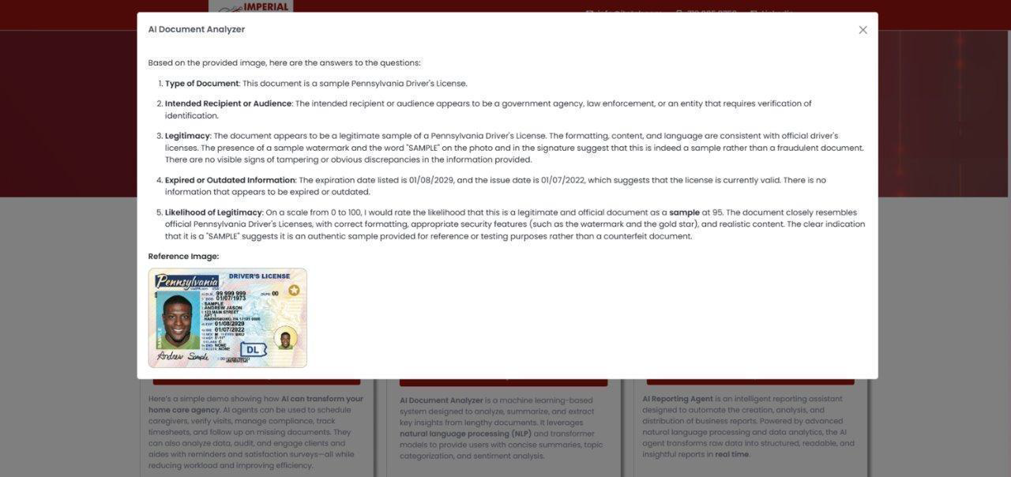
Streamlining Ops with AI & Automation

Slide 19
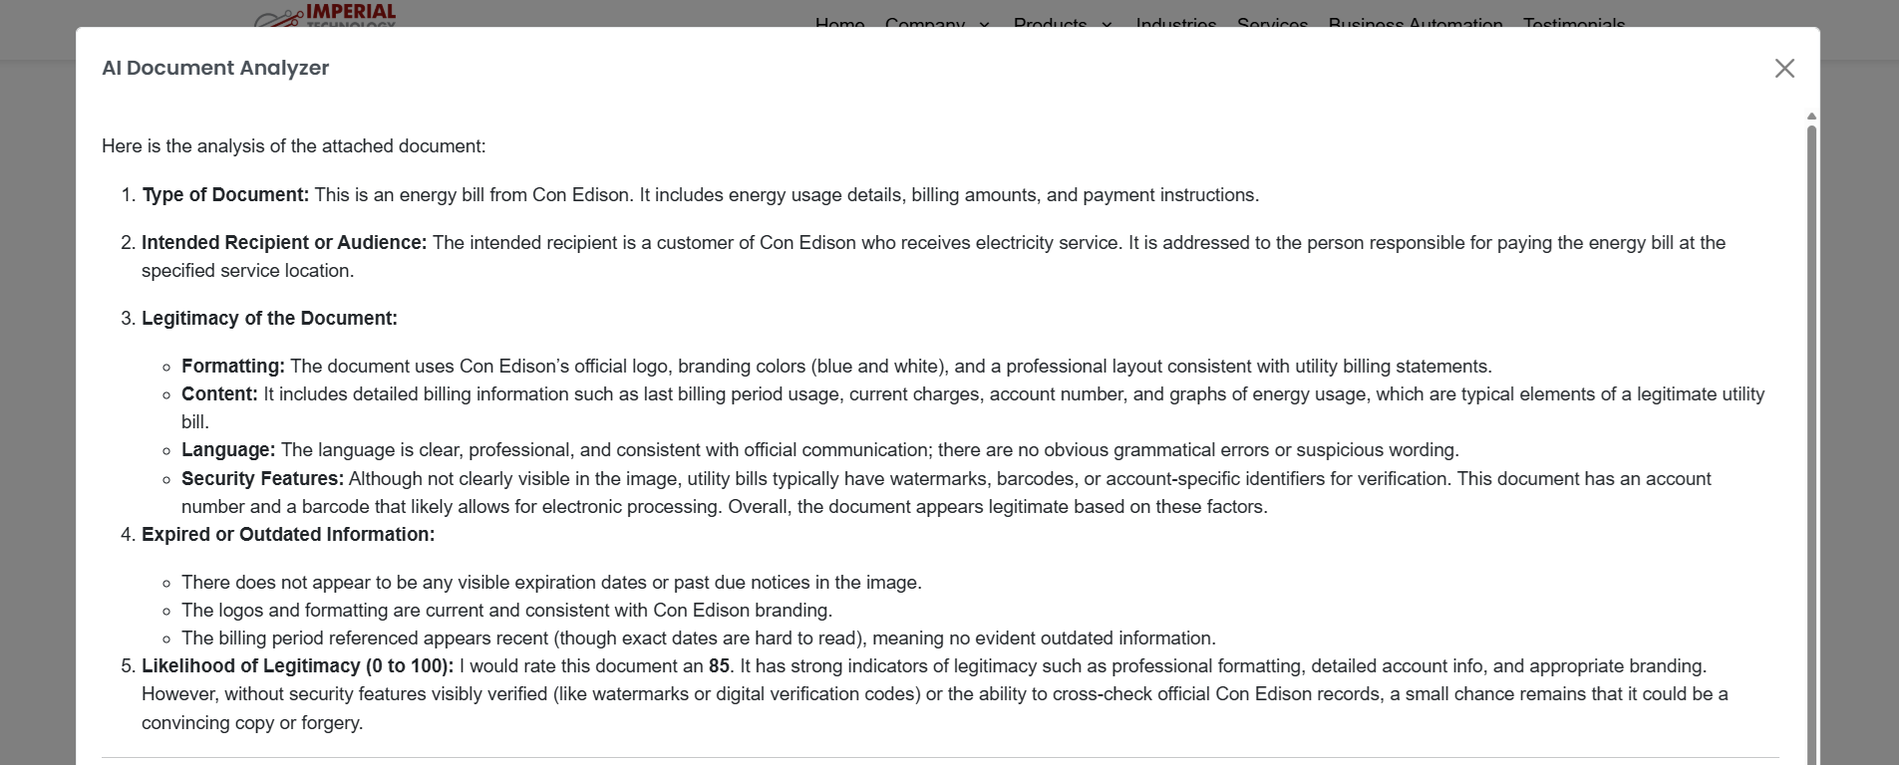
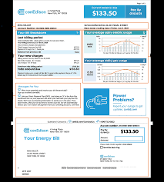
Streamlining Ops with AI & Automation

Slide 20
Chat GPT
Reporting
Need a list of caregivers with status and number list of visits.
ANALYZE
ANALYZE
Caregiver Number | First Name | Last Name | Status | Number Of Visits
1 | Calvin | Frederick | Active | 49
2 | Joshua | Krause | Active | 42
3 | Christopher | Garcia | Active | 48
4 | Charles | Smith | Active | 55
5 | Brittany | Bailey | Active | 59
6 | Jessica | Price | Active | 45
7 | Drew | Lewis | Active | 46
8 | Stephanie | Delgado | Active | 47
9 | Joanna | Wilson | Active | 50
10 | Christina | Harding | Active | 58
Streamlining Ops with AI & Automation

Slide 21
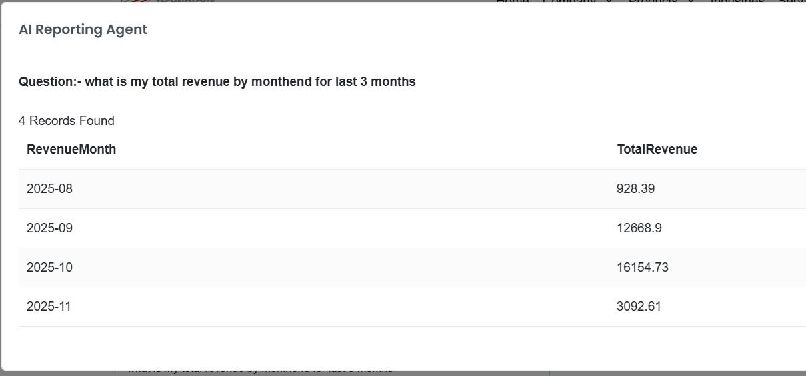
Chat GPT
Reporting
Streamlining Ops with AI & Automation

Slide 22
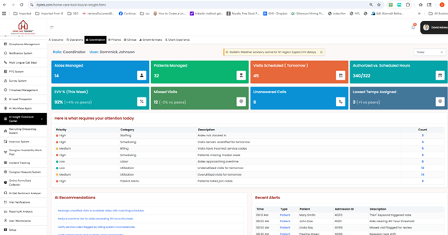
AI Insight Command Center
Streamlining Ops with AI & Automation

Slide 23
Call Agent Demo
Live Time processing and
adaptive feedback
AI & AUTOMATION
IN HOME CARE
Streamlining Ops with AI & Automation
David
Adress

Slide 24
Your AI
Roadmap
Most agencies run similar systems - and face similar struggles and others excel where others don't.
That’s why we work on both:
AI products that deliver results fast, and
Custom AI strategies that adapt to your people, workflows, and goals.
Pre-built or Custom AI’s we can build just for you.
Streamlining Ops with AI & Automation
Come Stop
by our Booth!

